Slide 1

What a year! 2013
Our Great Season
Our Great History
Our Great Future

Slide 2

What a year! 2013
Big Thanks
Our Board
Our Committee
Our Volunteers
Our Suppliers
Our Sponsors
Our Former Players
Our Supporters
To the GHFA.

Slide 3
What a year! 2013
Our Great Season
115 Minis players in 16 teams
170 Junior players 13 teams
120 Senior players in 7 teams
11 x Finalists of 20 teams
3 x Pennant Winners
7 x Grand Finalists
6 x Champions
4 x Premiers – two in Seniors
Club Championship – TOP TEN!!!

Slide 4
What a year! 2013
Mini’s Wrap
Six x Under 6 Teams. Tx to Kelly as U6 Co-ordinator
Six x Under 7 Teams. Tx to Fiona as U7-Co-ordinator
Five x Under 8 Teams. Tx to Sarah as U8 Co-ordinator
Superb Co-operative Coaching from KICKSTART
Big Thanks to Helen, Donna and Kelly on Tuesday Canteen
Big Thanks to Lisa and Holly on Game Day Canteen
Big thanks to all our BBQ Volunteers
Minis Coach of the year ; Dave Krizan U7 Red
Minis Manager of the year ; Tim Mortimer U7 Green
All on North Ryde Oval every Saturday!
Fabulous Training Tops
Lots of Fun

Slide 5
What a year! 2013
Junior Wrap
117 players in 13 Teams
Junior Licences for 12 of our Coaches
U9/1 - A great first season in Juniors – well done Dave and Steve and the team
U9/5- A great first season in Juniors – well done Pierre and Reid and the team
U10/2 Blue- Premiers and Grand Finalists. Well done to Dave, Darren and the team
U10/2 Red- Finalists. Well done to Tibor, Lisa and the team
U10/7- A great season of football – Well done to Darren and Cathy and the team
U11/2- Champions. Well done to Ando, Rob and the team
U11/3- A great season – Well done to Berny, Chris and Kerrie and the team
U11/7- Champions. Well done to Wayne, Jonno and the team

Slide 6
What a year! 2013
Junior Wrap
117 players in 13 Teams
Junior Licences for 12 of our Coaches
U12s – A great season. Well done to Daniel, Paul, Michael and the team
U13s – Premiers and Champions – Undefeated. Well done to Tim, Tony, Martin and the team
U14s – Champions. Well done to Ado, Sharon, Linda, Tony and the team
U15s – Champions – Well done to Peter, Victor and the team
U17s- Pennant Winners- Well done to Paul, Pete, Joe and the team
Junior Coach of the Year; Adrian Tamplin – U14s
Junior Manager of the Year: Lisa Shaw – U10/2 Reds

Slide 7
What a year! 2013
Linking our current Juniors with our past Juniors
Our 2013 President’s Selections
U9 – Jack Anderson, Rhys Dunn, Liam Wilson and Ashton Gleeson
U10 – Connor Hrncic, Isabel Snowden, Sam Jones and Ari Balogh
U11- Raphael Fimmano, Luke Wood, Daniel Bolton and Ben Stehn
U12 – Kan Izumi.
U13- Chris Borg
U14- Daniel Viana
U15- Yoshi Kan
U17- Lewis Rosenfels
Congratulations on the way you played in the big game!
The opportunity to play with our golden generation players in a showcase of NRSC Football Talent!

Slide 8
What a year! 2013
Club Person of the Year
The driving force behind Minis, Coaching his son’s team, helping out with U10s, Up at the oval every Saturday setting up, Playing in Over 35s – Premiers.
Club person of the year Mark Milne

Slide 9
What a year! 2013
Senior’s Wrap- Highlights!
The push into 45s.
The strengthening of 35s with new talent and upgrading players.
Training together on Wednesday night with the bbq and beers
Singing the Club Song
Supporting our other senior teams
The huge day at NR Oval cheering AA9s
Playing for the other teams when needed

Slide 10
What a year! 2013
SENIORS FOOTBALL
45-3 Brand new team, solid!
45-2 Old legends finally accept they are getting older!
AA6 Finalists
AA17 Pennant Winners
35-4 Pennant Winners
35-2 Premiers!
AA9 Premiers and Champions!

Slide 11
What a year! 2013
SENIORs: A special mention
The guy that we believe gave the most to his team, his team-mates and their success on and off the park!
Congratulations:
Steve Moore as Senior Team Manager of the Year and happy 40th Birthday!!

Slide 12
What a year! 2013
Our 60th Birthday!
Celebrations including
  Our Golden Generation
  Welcoming our former players including our Life Members
  Our Hall of Fame
  Cup-Cakes, Birthday cakes and Tonight’s function!

Slide 13
What a year! 2013
Our Golden Generation – The current era!
2003 – 2013 The quality we have produced
The great players
The great teams

Slide 14
What a year! 2013
Our Golden Generation – The current era!
The best team of the era:
The U9s to U11s Super Div 1 Side from 2009 to 2011.
The Team

Slide 15
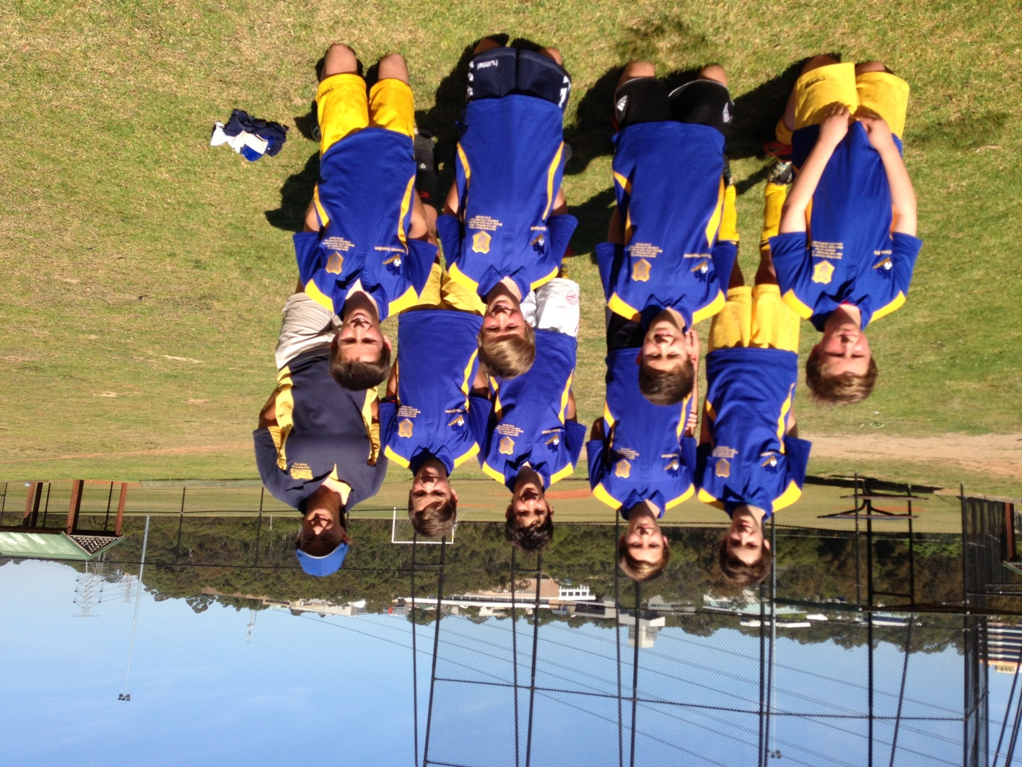
What a year! 2013
The Super Div1 One - U9s to U11s from 2009 to 2011.

Slide 16
What a year! 2013
The U9s to U11s from 2009 to 2011.
The Team
behind
the team!

Slide 17
What a year! 2013
The best team of the era:
The U9s to U11s from 2009 to 2011.
Their Achievements
3rd in 2009 – U9 Div 1
Joint Grand Final Winners in 2010 – U10 Div 1
Premiers in 2011 – U11 Div1
Champion of Champions Representatives 2011
The quality with which they played
The sportsmanship of this team
The quality of guidance, training and support they received
The fine players and young men they are becoming!

Slide 18
What a year! 2013
Our Golden Generation – The current era!
The best Junior players of the current era – 2004- 2013

Slide 19
What a year! 2013
The best Junior players of the current era – 2004- 2013
How they would take the field!

Slide 20
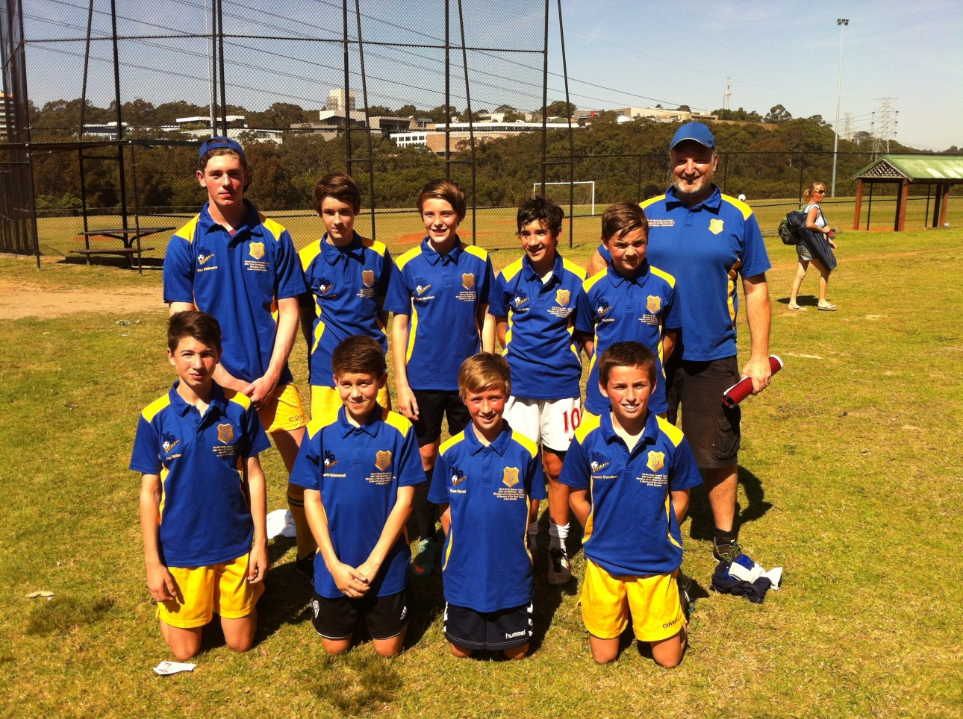
What a year! 2013
The best Junior players of the current era – 2004- 2013
The Lads on the big day!

Slide 21
What a year! 2013
Our Past and our Present. The Firgal Adam’s Cup
Firgal Adams means a lot to this club. A long-standing player but also a huge part of the social fabric that binds our club.
In 2013 we recognise Firgal’s contribution with the Firgal Adam’s Cup.
Each year all our Senior teams will play in an end of season round robin for the right to win this cup.
On Saturday 7th September 2013 , these games were played in great spirit and it came down to a penalty Shootout in the finals!
The Inaugural winners – Ando and his 35 Div 2 Side!

Slide 22
What a year! 2013
Our Past
Our Life Members
What does this honour mean
Who are they
Our Hall of Famers
What does this honour mean
Who are they
Our Former Players

Slide 23
What a year! 2013
Our Current Life Members

Slide 24
What a year! 2013
The Existing NRSC Hall of Fame

Slide 25
What a year! 2013
Our Long Serving Awards

Slide 26
What a year! 2013
Our New Hall of Famers – Congratulation to each and everyone of you.

Slide 27
What a year! 2013
Our Future
Continue our focus on Minis’ players – our future
Develop our juniors to reach their potential.
Link our Juniors to our Seniors - First U18s team in forever!
Really launching the Strikers name on our club clothing!
Building a new All Age Team
Further strengthening Over 35s as we push back into Div. 1. Migrating the mature AA players!
Consolidating 45s and getting other oldies back on the park. Migrating the older 35s!
Developing community links and sponsors
Our next generation leaders!

Slide 28
What a year! 2013
Wrap up
Thank you to everyone involved in North Ryde Soccer Club, in the past, the present and the future
Congratulations to all our award recipients
Well done to all our teams
See you back in 2014!!

